Slide 1
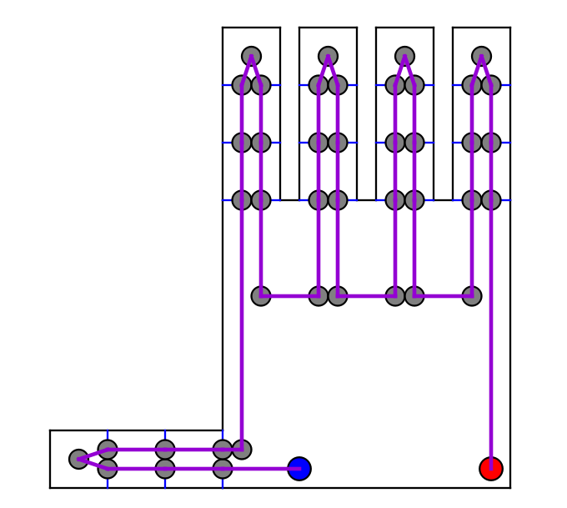
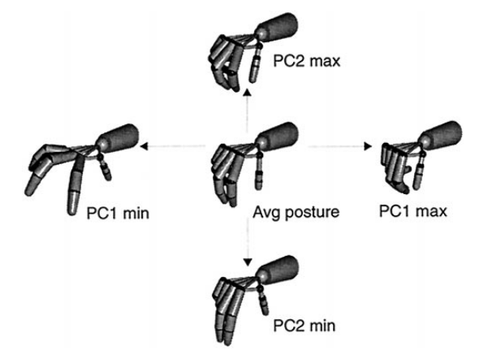
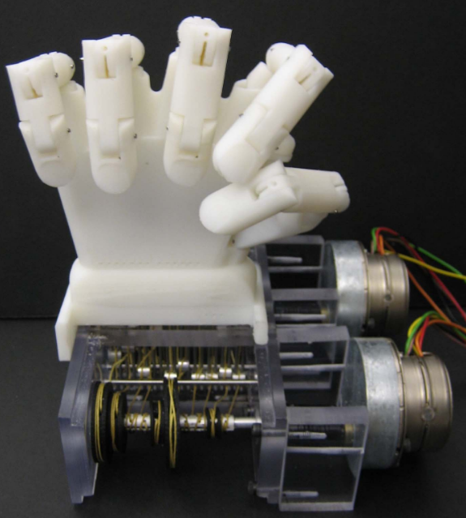
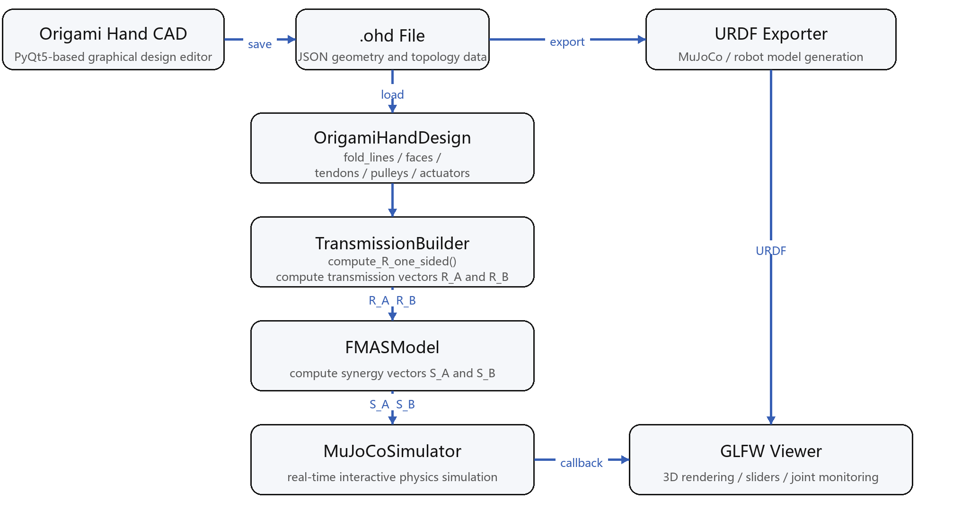
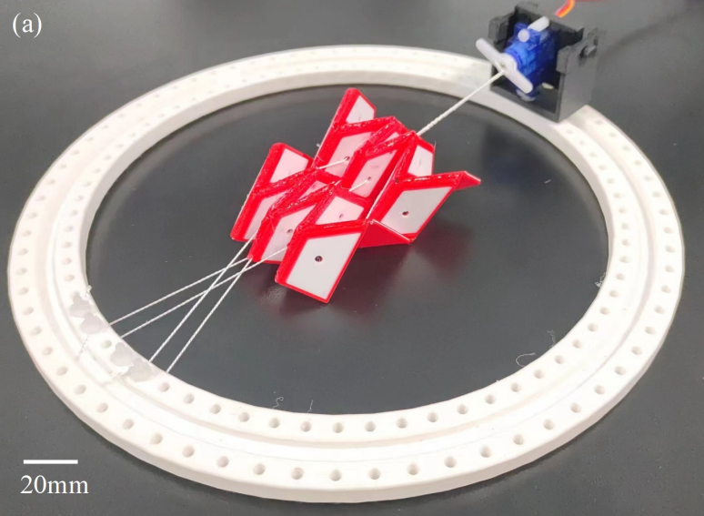
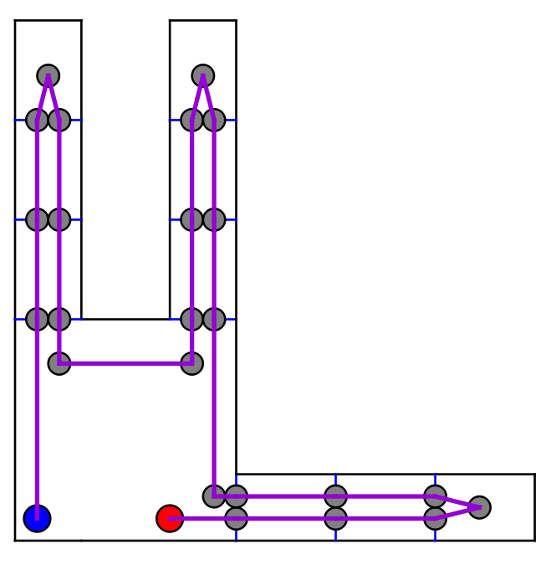
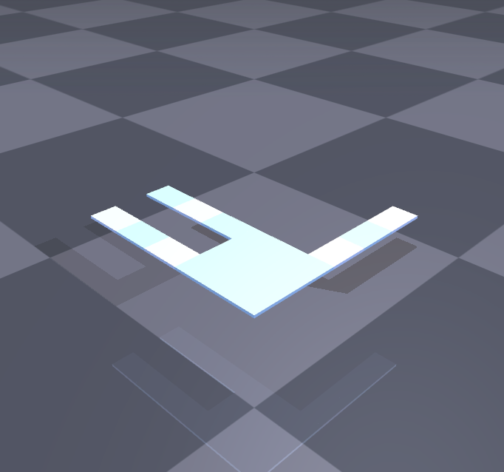
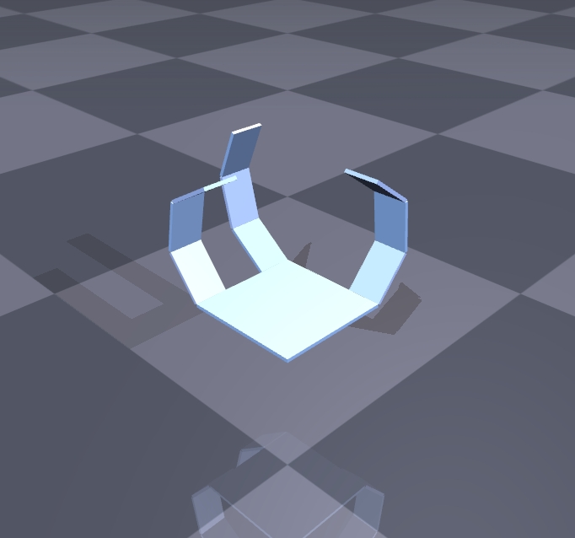
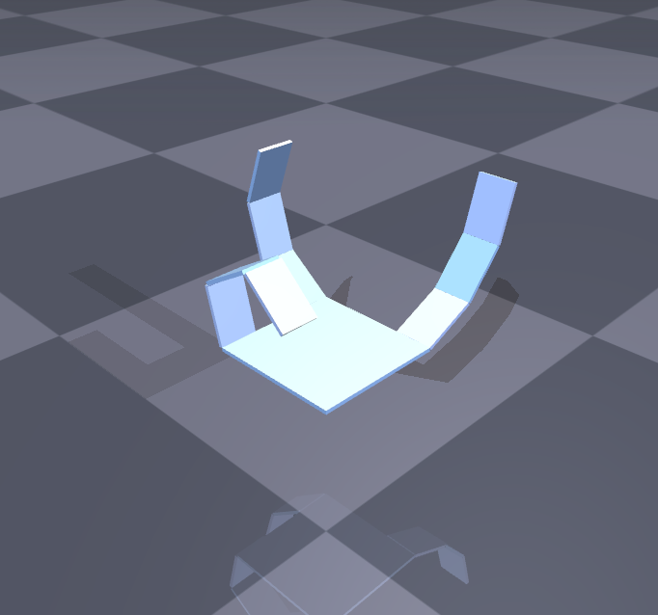
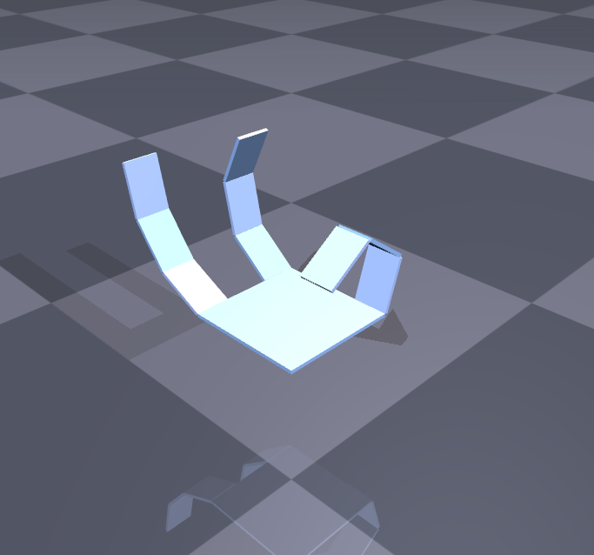
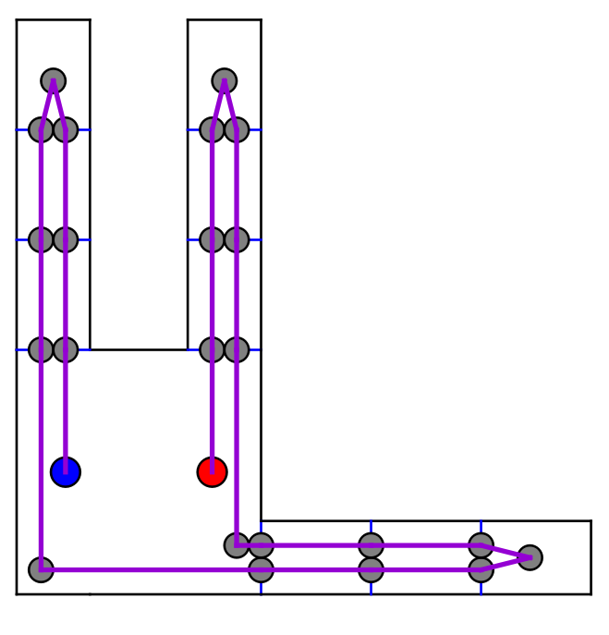
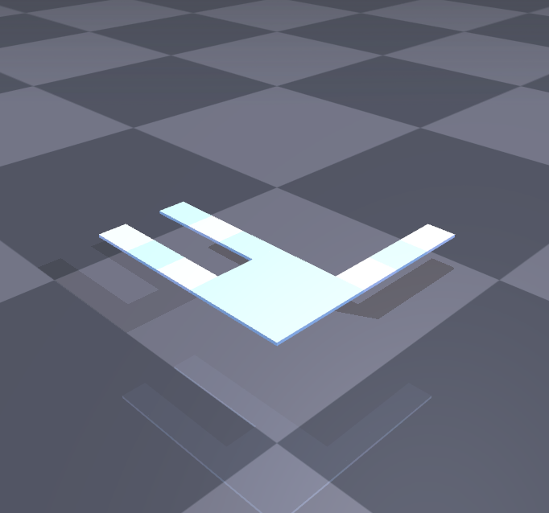
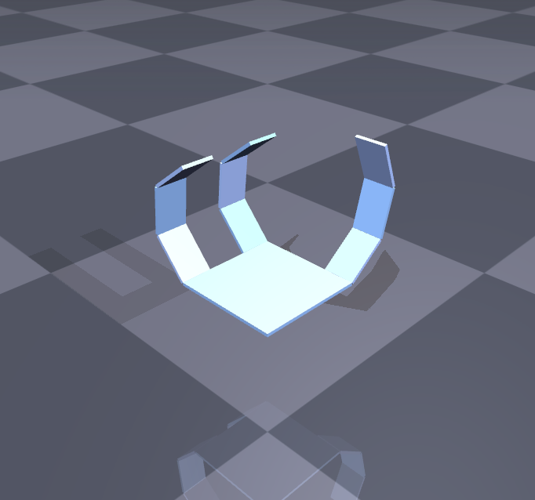
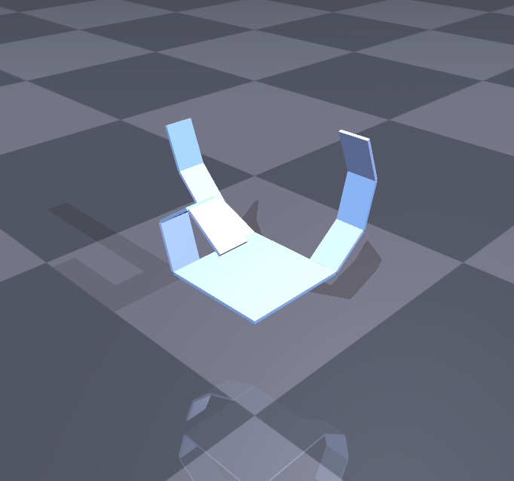
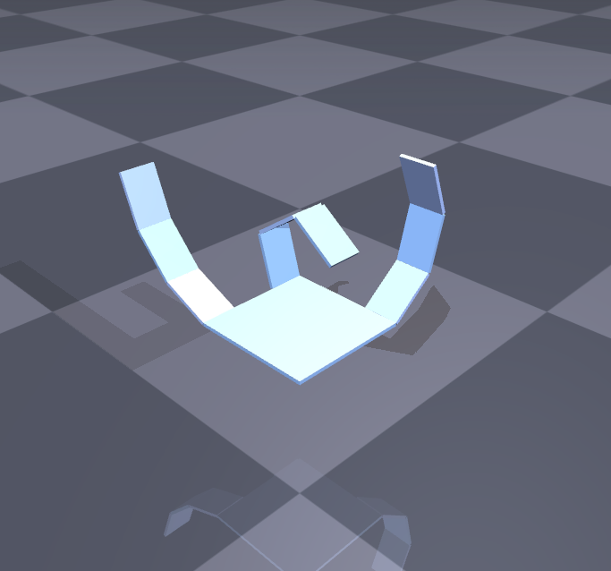
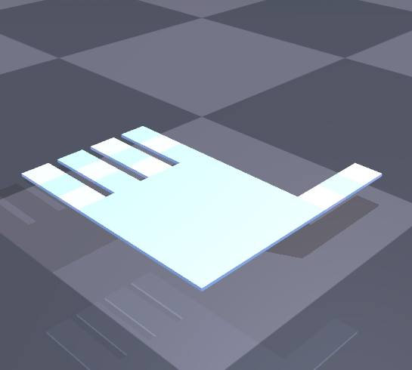
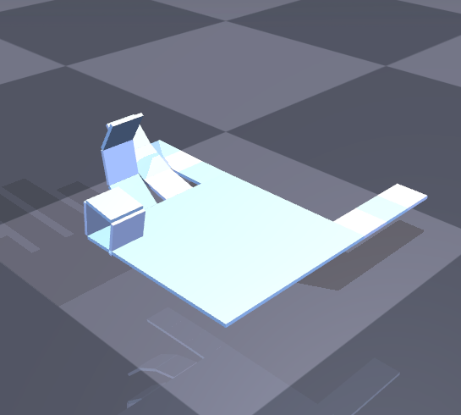
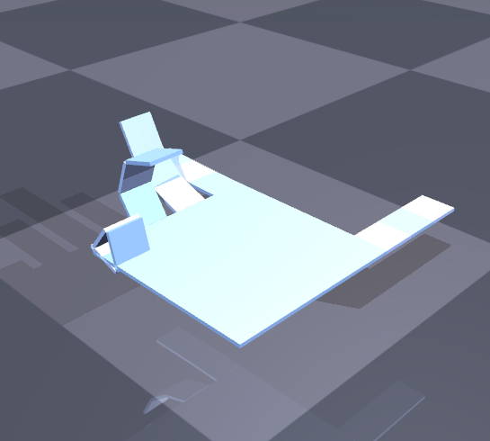
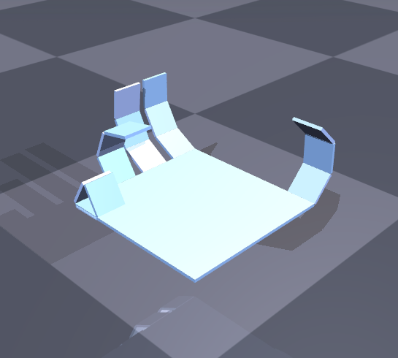
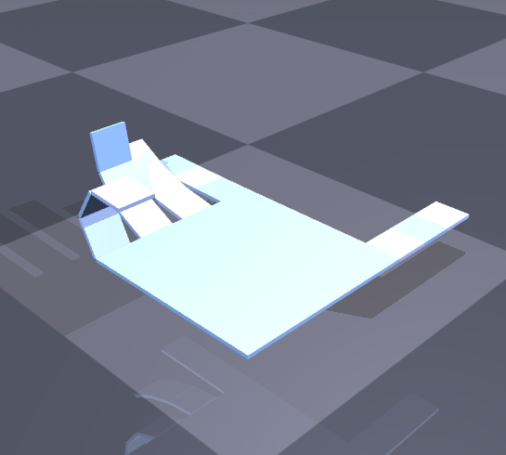
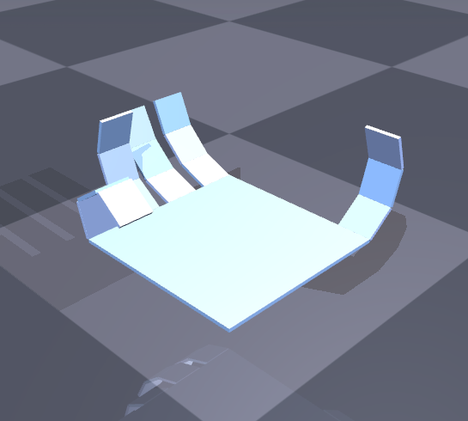
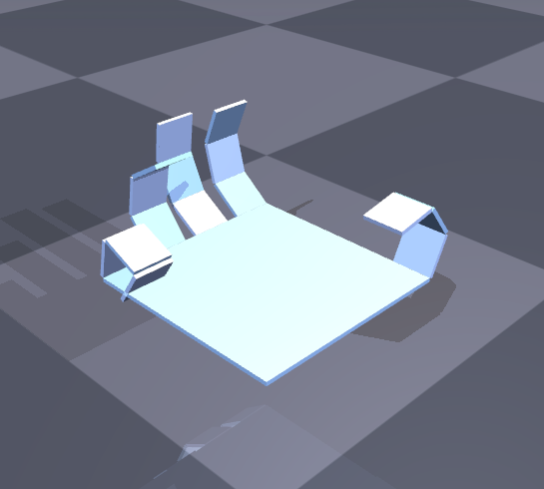
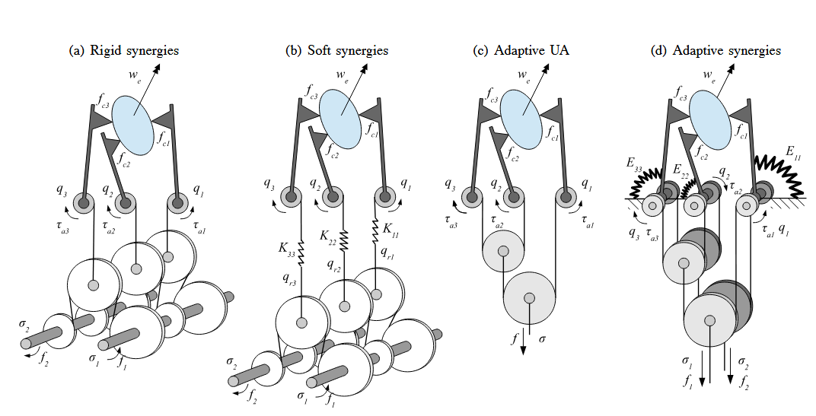
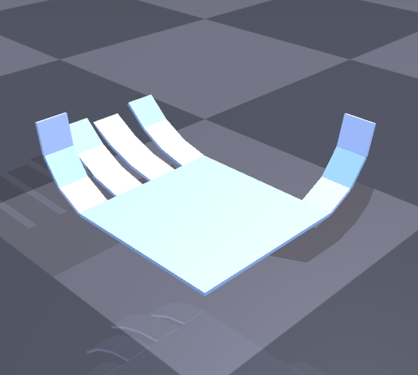

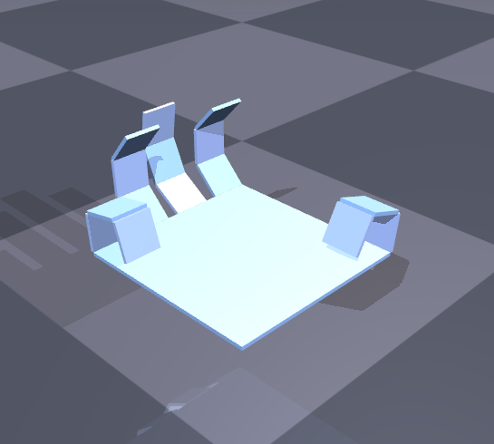
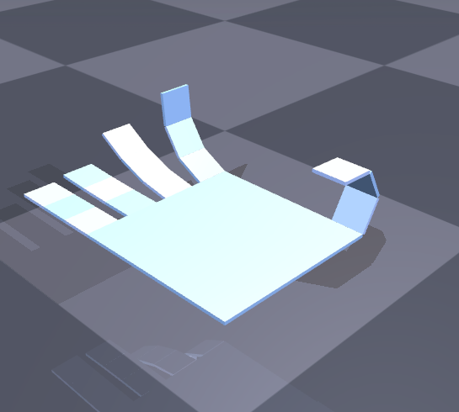
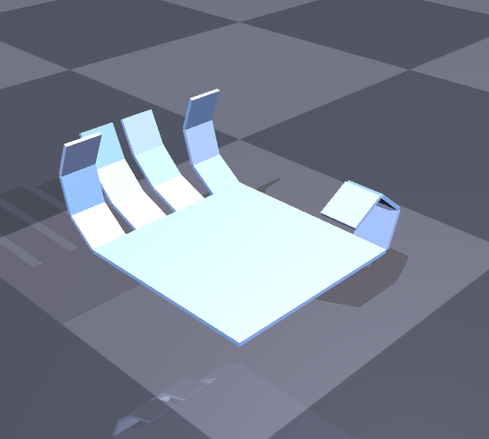
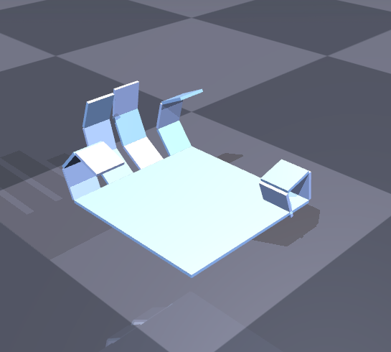
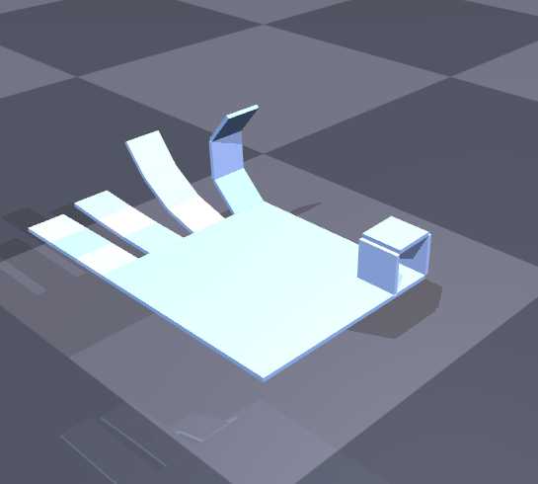
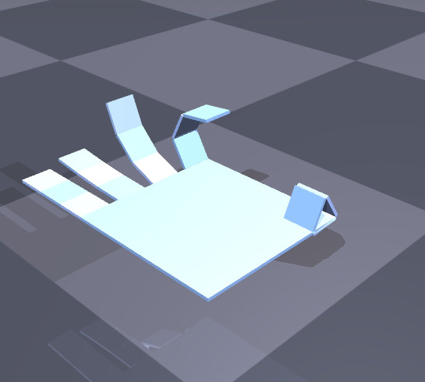
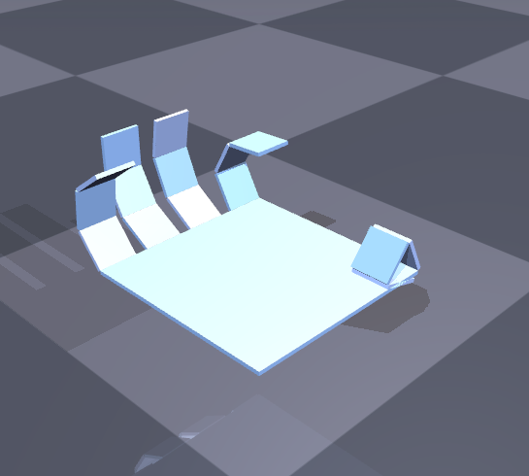
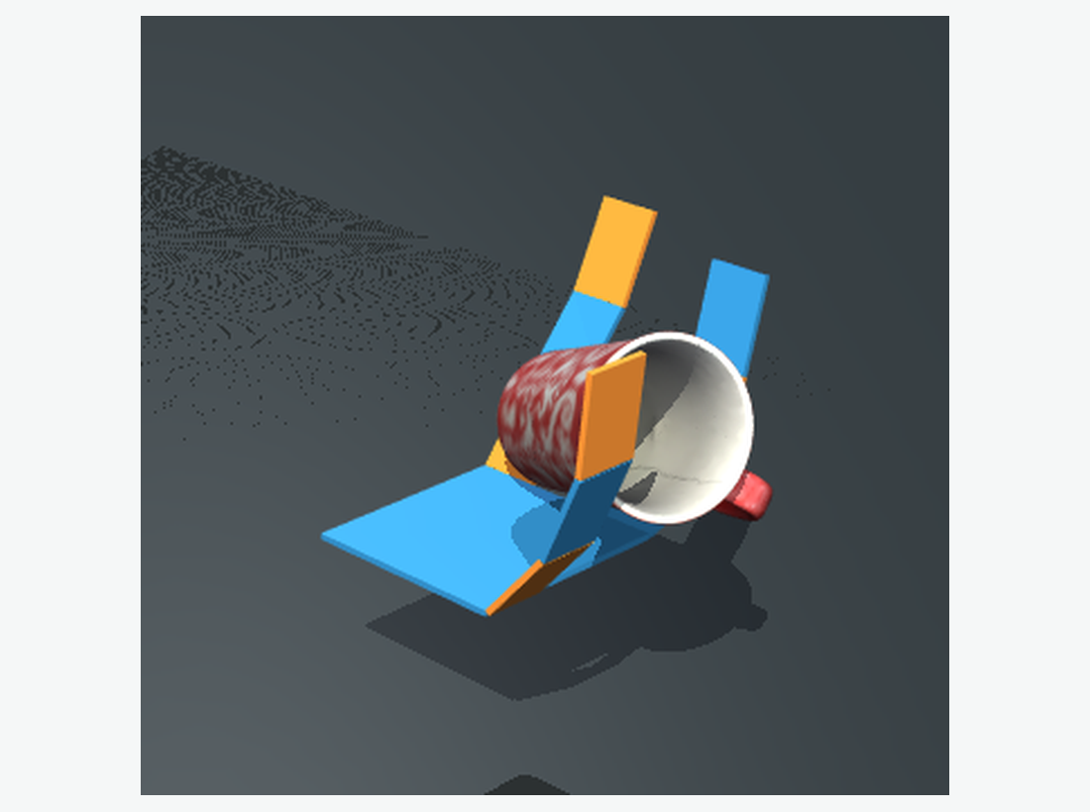
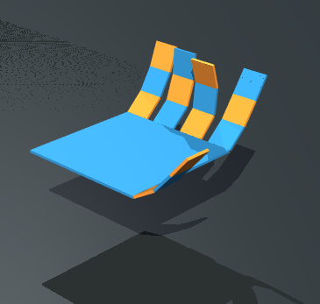

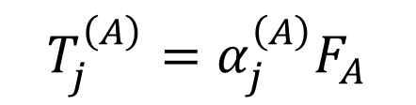
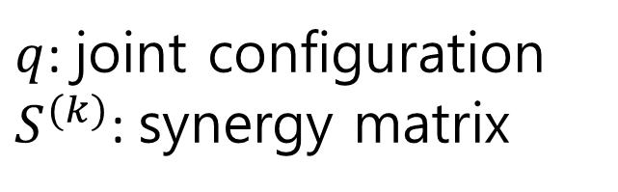

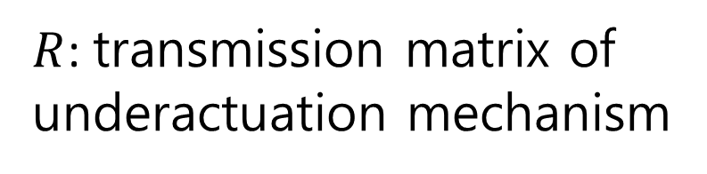



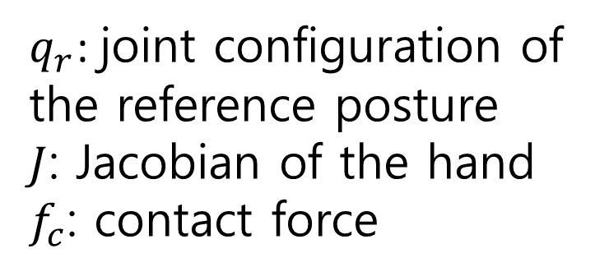



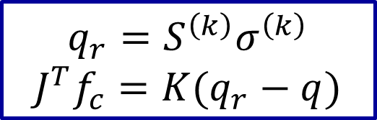





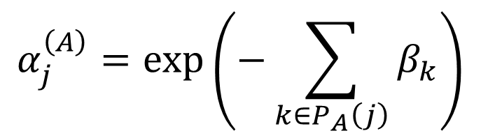
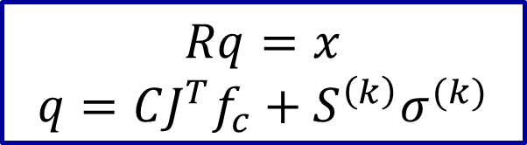
Modeling Adaptive Grasping in a String-Driven Origami Hand
Introducing FMAS: a friction-modulated tendon transmission model connected to MuJoCo contact simulation
Yushuo Wang
Problem Statement
Methodology
Postural Synergy Theory
Friction-Modulated Adaptive Synergy(FMAS)
Human hand motion has many degrees of freedom, but grasping postures are not controlled as independent joint commands. A classical observation in hand neuroscience is that many hand shapes can be approximated by a small number of postural synergies: low-dimensional variables coordinate high-dimensional joint configurations.
$$T_{j}^{\left(A\right)}=α_{j}^{\left(A\right)}F_{A}$$
(Capstan friction)
$$α_{j}^{\left(A\right)}=\exp\left(−\sum_{k∈P_{A}\left(j\right)}{β_{k}}\right)$$
$$J^{T}f_{c}=R_{A}^{T}F_{A}+R_{B}^{T}F_{B}−Eq$$
a two-ended closed-loop tendon driven hand
the first 2 PCs of human hand grasping
$$q=S_{A}x_{A}+S_{B}x_{B}+CJ^{T}f_{c}$$
The origami hand is not treated as a conventional fully actuated kinematic linkage. Its folds, compliant creases, and routed tendons create a differential-like underactuated mechanism. In a two-ended closed-loop tendon, pulling from side A and pulling from side B are not equivalent because tension propagates through different routed paths. A fixed transmission matrix can describe one nominal reference motion, but it cannot explain this direction-dependent transmission. Therefore, this project introduces a two-ended tendon-driven synergy model and connects it to numerical contact simulation.
The .ohd design file defines the origami hand geometry: faces, creases, joints, holes, actuators, and routed tendons.
The FMAS layer converts the two-ended tendon routing into a distribution matrix. Pulling from side A and side B gives two one-sided transmissions, R_A and R_B, which generate two synergy bases.
mechanical implementation of synergy
String-driven origami
The simulation problem has two connected levels. The geometric and kinematic level explains what motion the origami hand design and tendon routing are intended to produce. The physical simulation level then asks how this reference motion is realized when the hand is represented as an articulated model and advanced through numerical integration and contact constraints. MuJoCo is used to solve the time response q(t), contact count, contact force, and object interaction.
The central simulation question is: how can a string-driven origami hand design be simulated across geometry, synergy transmission, numerical dynamics, and contact.
Experimental Results
Case Ⅰ
$$σ_{c}=0, σ_{d}=0$$
$$σ_{c}=22, σ_{d}=0$$
$$σ_{c}=22, σ_{d}=11$$
$$σ_{c}=22, σ_{d}=−11$$
Literature Review
$$σ_{c}=0, σ_{d}=0$$
$$σ_{c}=22, σ_{d}=0$$
$$σ_{c}=22, σ_{d}=11$$
$$σ_{c}=22, σ_{d}=−11$$
Postural synergy studies show that high-dimensional hand postures can often be represented by a few low-dimensional coordinates. This motivates synergy-driven hands: a small number of commands can organize many joints into coordinated grasping motions.
Soft synergy models add an important physical interpretation. A synergy command should not be treated as a rigid final posture, but as a compliant reference. When the hand contacts an object, the realized posture can deviate from the reference due to external forces and structural compliance.
Adaptive synergy demonstrate how this idea can be implemented mechanically. A tendon transmission maps actuator displacement into multiple joint coordinates, while passive compliance allows the hand to adapt during contact.
simulation results for a three-finger gripper with two different tendon routes
Case Ⅱ
$$\begin{aligned}&σ_{d} \\ \#\#\end{aligned}$$
22
11
0
-11
-22
$$\begin{aligned}&σ_{c} \\ \#\#\end{aligned}$$
0
11
22
33
simulation results for a five-finger origami hand
Rigid Synergy
Case Ⅲ
$$q=S^{\left(k\right)}σ^{\left(k\right)}$$
Core idea: A high-dimensional hand posture can be approximated by a low-dimensional set of fixed synergy coordinates.
$q$: joint configuration
$S^{(k)}$: synergy matrix
Soft Synergy
$$q_{r}=S^{\left(k\right)}σ^{\left(k\right)}$$
$$J^{T}f_{c}=K(q_{r}−q)$$
Core idea: The synergy command defines a reference posture, while compliance and contact forces allow the actual hand shape to deviate from it.
grasping contact numerical simulation results
$q_{r}$: joint configuration of the reference posture
$J$: Jacobian of the hand
$f_{c}$: contact force
Conclusion
This project presents a physics-aware simulation framework for a string-driven origami dexterous hand. The geometric layer converts .ohd designs into hand topology, URDF/STL geometry, tendon routing, and reference synergy motion.
The proposed FMAS model derives physically interpretable closing and redistribution modes from the two-ended closed-loop tendon transmission, instead of prescribing a fixed synergy basis.
The MuJoCo layer converts these model-derived inputs into numerical time integration and contact simulation, producing joint trajectories, contact statistics, screenshots, GIFs, and auditable MJCF files.
Adaptive Synergy
Core idea: A mechanical transmission maps a small number of actuator displacements into many joint coordinates, realizing synergy through underactuation.
$$Rq=x$$
$$q=CJ^{T}f_{c}+S^{\left(k\right)}σ^{(k)}$$
$R$: transmission matrix of underactuation mechanism

